Slide 1
DataStax Enterprise 6 Solution Day

Slide 2
Agenda

Slide 3
Information Search
Query by non-pk
Notes:
Now I’d like to show you Cassandra in action and what that experience is like, working with CQL in DataStax Enterprise

Slide 4
Information Search
Multi-criteria WHERE Constraints
WHERE constraints with multiple columns
No extra tables needed
Full Text Search
Wildcards ? *, like or Lemmatisation
Faceting, Slice and Dice
Live Indexing
Real Time Search, High Index throughput
Geospatial queries
Queries with coordinates and distances search
https://docs.datastax.com/en/dse/5.1/dse-dev/datastax_enterprise/search/tutorialsDemosTOC.html
https://github.com/phact/docker-silk-dse
Notes:
lemmatization is to reduce inflectional forms and sometimes derivationally related forms of a word to a common base form. For instance:
am, are, is be car, cars, car's, cars' carThe result of this mapping of text will be something like:the boy's cars are different colors the boy car be differ color
Lemmatization usually refers to doing things properly with the use of a vocabulary and morphological analysis of words,
ELK Stack

Slide 5
Query by non-PK
CREATE Search INDEX on notifications WITH COLUMNS activity;
SELECT * FROM notifications WHERE 'activity' LIKE 'cre%';
Range Queries (with open bounds possible)
SELECT * FROM taxi_trips
WHERE 'pickup_dropoff_range' > '2017-02-01T12'
AND 'pickup_dropoff_range' < '2017-02-02';
Filter operators, such as LIKE, IS NOT NULL, range, and =/!= are supported!
Geo-Spatial Search
SELECT * FROM test WHERE solr_query=
'{"q":"*:*", "fq":"point:\"IsWithin(BUFFER(POINT(4.0 49.0), 10.0))\""}’;

Slide 6
Querying through CQL
SELECT * FROM notifications WHERE 'activity' LIKE 'cre%';
activity
------------------------------
mike created account
tom created account
How many nodes to contact?
We don't know the primary key
Theory:
contact at least one replica for every token range
Cassandra contacts all nodes
Our custom Solr SearchComponent does intelligent shard selection
Notes:
6/20/18
6
6

Slide 7
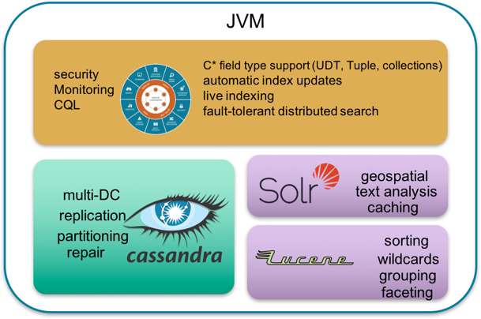
DSE Search Architektur
Integrated in the the same JVM
Data Locality (TokenRanges) and Shared Memory
High Available, no master needed
Index is sharded to all nodes
Transparency
Access via CQL or REST API
Automated indexing with INSERT / UPDATE
No extra ETL Process needed

Slide 8


The Open Source Way
Application
Separated Search Cluster
“Split Brain” risk, data inconsistency
ETL to generate, update and re-create index
Complex application
Two seperated APIs, driver, read pathes
DB API
Solr API
Manuel ETL Re-Indexing ...
Apache Solr™
Cluster
Apache Cassandra™
Cluster
https://docs.datastax.com/en/datastax_enterprise/5.0/datastax_enterprise/srch/searchOssSolrDiff.html

Slide 9
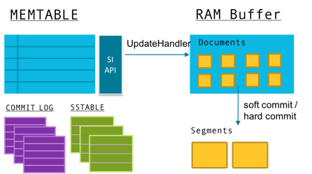
Inserting with DSE Search enabled
Replica node
user_id : 4 name : SearchKing
Coordinator
CQL insert
MEMTABLE
RAM Buffer
SI API
UpdateHandler
Documents
CQL insert
user_id : 4 name : SearchKing
COMMIT LOG
SSTABLE
soft commit /
hard commit
Segments
CQL insert
Replica node

Slide 10
Agenda

Slide 11
Thank you

